Slide 1
Infrastructure Planning Grant
Application Process
Submit an Application

Slide 2
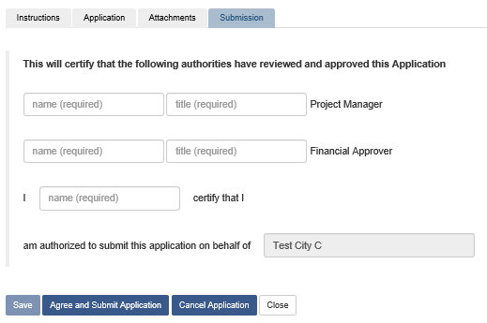
Submit an Infrastructure Planning Grant Application
This guide will teach you how to submit an Infrastructure Planning Grant Application. You will need to have created and completed an application in order to follow this guide. Please see the Viewing an Infrastructure Planning Grant Application PowerPoint on the LGIS Training site if you don’t know how to open an application.
*Note: LGIS is best viewed using Internet Explorer 11 with add-ons disabled.

Slide 3
With your application form open; click on the Submission tab. Complete required fields.*
*Note: The date you submit your application becomes the first eligible cost date.

Slide 4
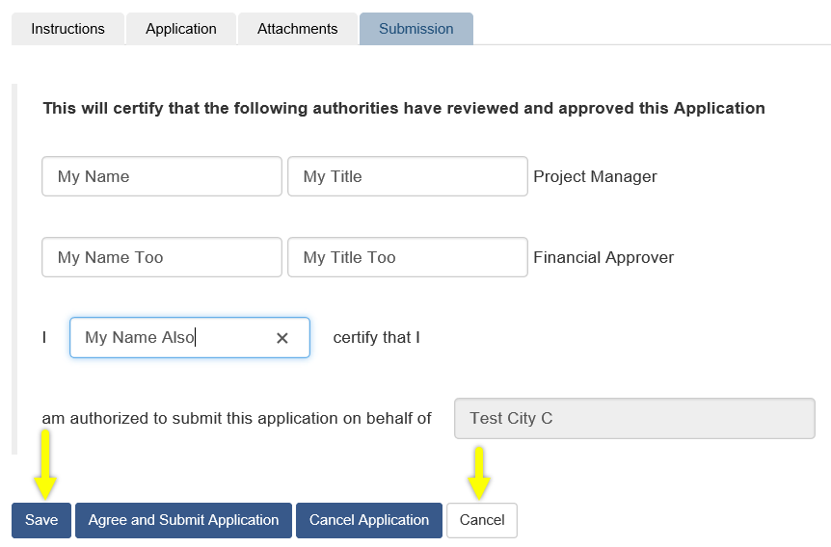
After filling out the required fields you will notice the Save button is now enabled. Also, the Close button now says Cancel

Slide 5
You now have four options:
Cancel your last unsaved changes and return to the Applications screen.
Cancel the entire application.
Save then Close the application, allowing you to return to the application and make edits at a later date.
Agree and Submit the application, submitting the application to the Ministry.*
*Note: Once your application is submitted, the form can no longer be edited. If edits are required, please contact the Ministry.

Slide 6
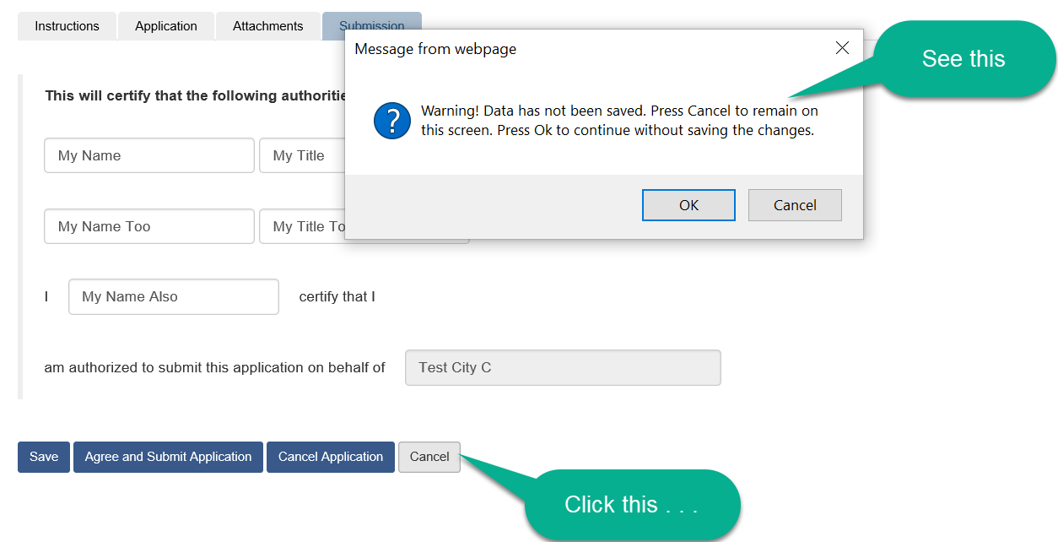
Cancel unsaved changes and return to the Applications screen
When you click the Cancel button you see a warning message. Click Cancel in the pop-up to remain on the Submission tab. Click OK in the pop-up to return to the Applications screen.

Slide 7
If you click OK in the warning pop-up you will be returned to the Applications screen. Notice the application you created is in Incomplete status.

Slide 8
If you click Cancel in the warning pop-up you will return to the Submission tab.

Slide 9
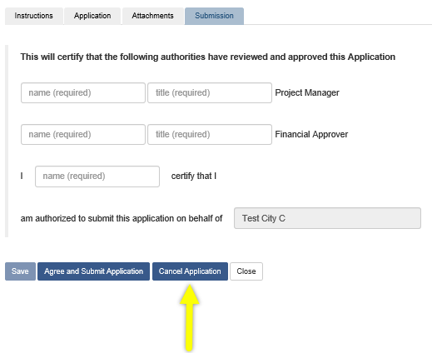
Cancel the application.
This option will cancel the entire application. You will not be able to return to the application, make edits or submit.

Slide 10
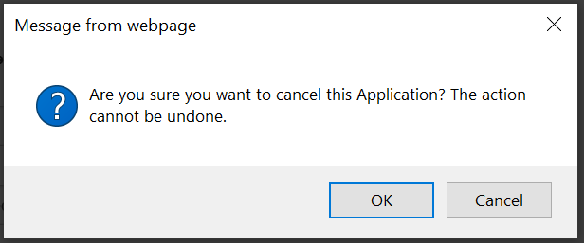
Cancel the application continued . . .
Click Cancel Application
You will see a pop-up message. Click OK to cancel the application. Click Cancel to return to the Submission page.

Slide 11
Cancel the application continued . . .
If you choose to click OK in the pop-up you will be returned to the Applications page. Notice the application you created is in Cancelled status.

Slide 12
Save then close
This option allows you to save all your changes and return to complete the application at a later date.

Slide 13
Save then close continued . . .
Click Save

Slide 14
Save then close continued . . .
After clicking Save you should see this success message.

Slide 15
Save then close continued . . .
Click Close

Slide 16
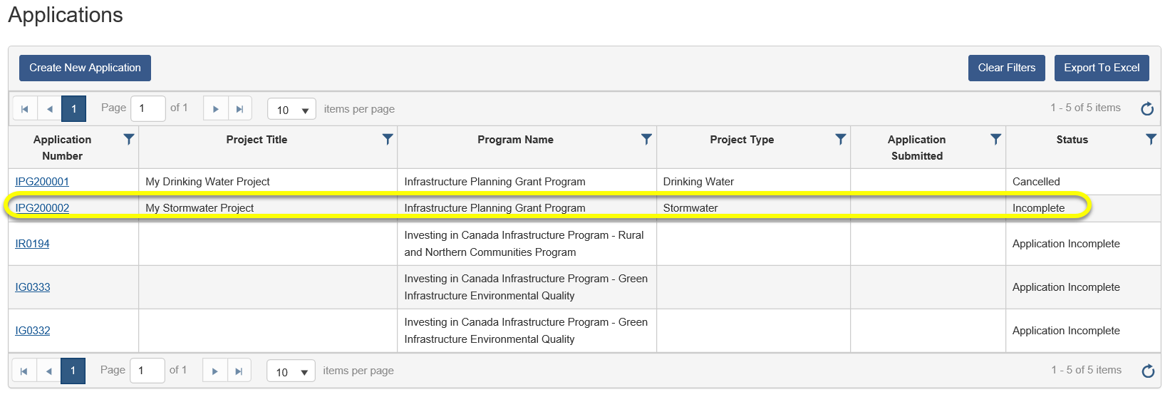
Save then close continued . . .
When you click Close you will be returned to the Applications page. Notice the application you created is in Incomplete status.

Slide 17
Agree and submit the application
This option allows you to agree to the statement on the Submission tab and submit your application to the Ministry.*
*Note: The date you submit your application becomes the first eligible cost date. Once your claim is submitted, the form can no longer be edited. If edits are required, please contact the Ministry.

Slide 18
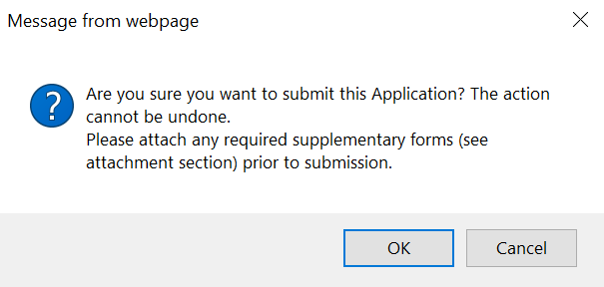
Agree and submit the application continued . . .
Click Save, then click Agree and Submit Application
Once you click Agree and Submit Application you will see this message

Slide 19
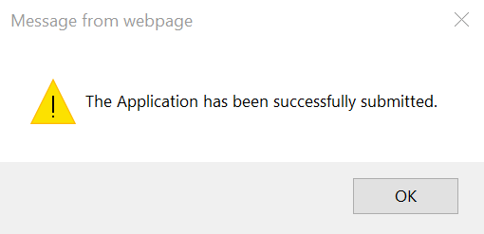
Agree and submit the application continued . . .
Click OK in the message box and you will see this success message.

Slide 20
Agree and submit the application continued . . .
Click OK in the message box and you will be returned to the Applications page. Notice your application is in Submitted status.

Slide 21
LGIS Website : https://www.localgovernmentinformationsystem.gov.bc.ca/EXT/default.aspx
For access and technical assistance please contact: Phone: (250) 953-3008* Email : LGIS.AccessRequest@gov.bc.ca*
For program and claim assistance please contact: Phone: (250) 387-4060* Email : infra@gov.bc.ca*
*Please allow response time of up to 2 business days.
Notes:
Confirm all info before publishing.

