Slide 1
Infrastructure Planning Grant Process
Open a Project

Slide 2
Opening an Infrastructure Planning Grant Project
This guide will teach you how to view existing Infrastructure Planning Grant Projects created by your organization. Multiple people can be given access to an organization’s applications and projects in LGIS (through BCeID).
*Note: LGIS is best viewed using Internet Explorer 11 with add-ons disabled.

Slide 3
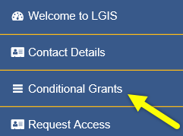
Start by clicking Conditional Grants

Slide 4
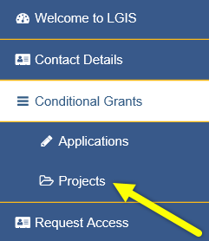
Then click Projects

Slide 5
Click on a Project Number link to open a project.*
*Note: Depending on program the project is funded under, screen display and navigation will vary. Claims can only be created for Active Projects. When a project is completed it can be viewed in LGIS in read-only mode under the Inactive Projects tab.

Slide 6
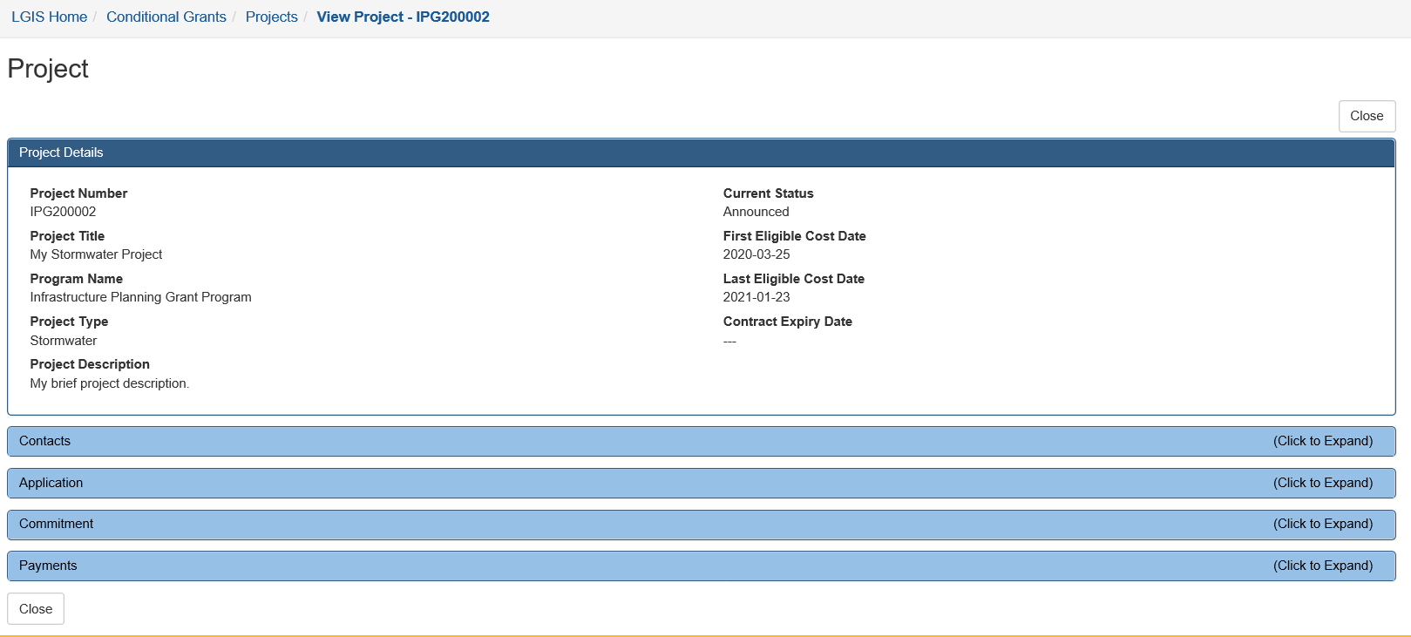
When you click on the Project Number link the Project page opens.
From this page you can create new claims, or view existing claims and disbursements.* You can also view your remaining grant balance, total payments and any commitment adjustments.
*Note: Project status must be “Announced”, “In Progress” or “Completed” in order to create a claim.

Slide 7
LGIS Website : https://www.localgovernmentinformationsystem.gov.bc.ca/EXT/default.aspx
For access and technical assistance please contact: Phone: (250) 953-3008* Email : LGIS.AccessRequest@gov.bc.ca*
For program and claim assistance please contact: Phone: (250) 387-4060* Email : infra@gov.bc.ca*
*Please allow response time of up to 2 business days.
Notes:
Confirm all info before publishing. Note: response time can be 1-2 business days?

