Slide 1
Infrastructure Planning Grant
Application Process
Create an Application
Notes:
Remove ministry name. center graphics.

Slide 2
Creating an Infrastructure Planning Grant Application
The LGIS Conditional Grants screen gives users access to create Grant applications and to view/manage active projects. Multiple people can be given access to an organization’s applications and projects in LGIS (through BCeID).*
*Important information for new users! Gaining access can take up to 5 business days*
Before you can access the online application form; your organization must create a unique Business BCeID username for you.
You will then, using your new Business BCeID username, be required to submit a LGIS Request Access form. Processing your request can take up to 5 business days.
Notes:
Donna to send rewrite of BCEID page. IPGP is local gov only. Local govs default have bceid accounts. Update language. 5 days not fifteen. Other access request info?

Slide 3
This guide will walk you through how to create an Infrastructure Planning Grant Application in LGIS. Let’s start at the LGIS Home screen. This is the first screen you see when you log in to LGIS.*
*Note: LGIS is best viewed using Internet Explorer 11 with add-ons disabled.

Slide 4
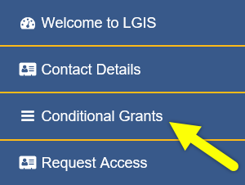
Start by clicking Conditional Grants

Slide 5
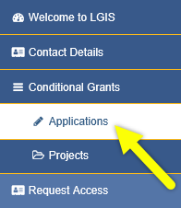
Then click Applications

Slide 6
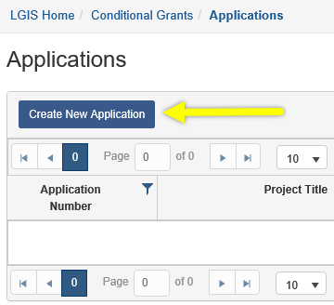
Then click Create New Application.

Slide 7
Using the dropdown menu, select Infrastructure Planning Grant Program.*
*Note: Clicking Close will return you to the Applications screen. No application record will be created.

Slide 8
After selecting Infrastructure Planning Grant Program, you will see the program’s Application Deadline and a link to additional Program Information.
https://www2.gov.bc.ca/gov/content/governments/local-governments/grants-transfers/grants/infrastructure-planning-grant-program
*Note: The Infrastructure Planning Grant Program provides for ongoing intake of applications. The “Application Deadline” indicated above is a system required field and NOT an enforced deadline.
Notes:
Actual program information link in TEST is incorrect. Correct in PPT

Slide 9
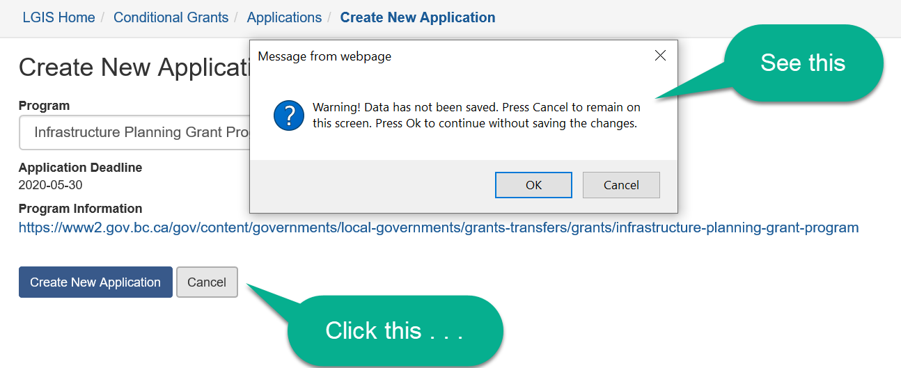
You may have noticed the Close button that was next to the Create New Application button now reads Cancel. Clicking Cancel will bring up a warning message.*
https://www2.gov.bc.ca/gov/content/governments/local-governments/grants-transfers/grants/infrastructure-planning-grant-program
*Note: Clicking OK will return you to the Applications screen. No application record will be created.
Clicking Cancel in the pop-up will return you to the Create New Application screen.

Slide 10
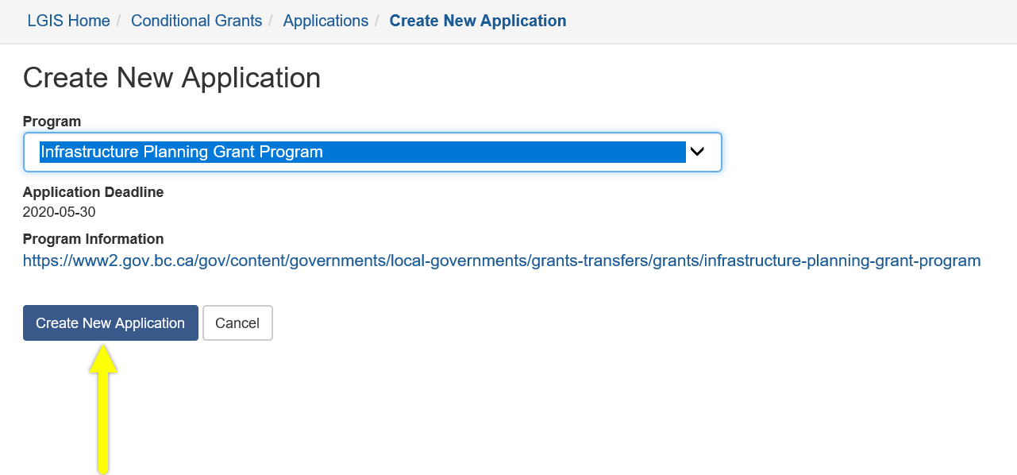
Click Create New Application to create an application form for your project.
https://www2.gov.bc.ca/gov/content/governments/local-governments/grants-transfers/grants/infrastructure-planning-grant-program

Slide 11
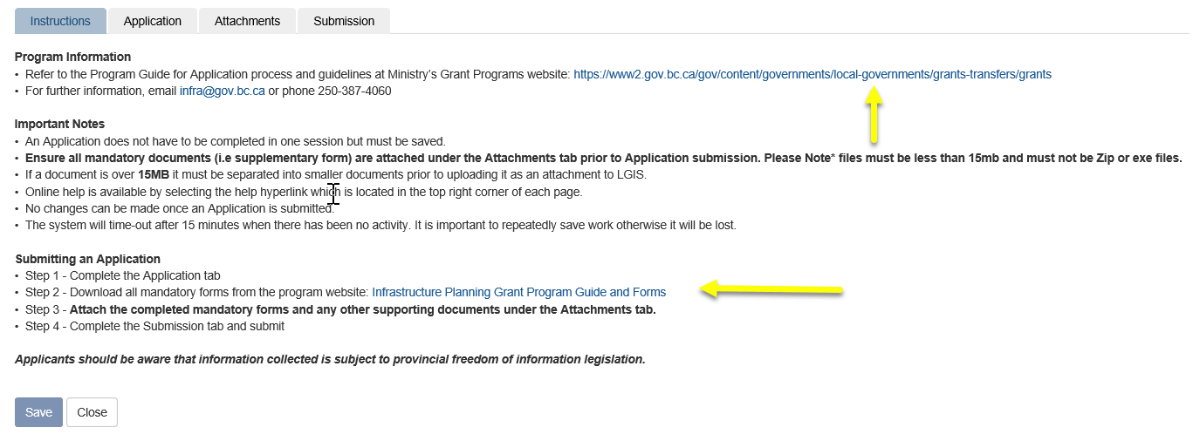
After clicking Create New Application you will see the screen displayed below. You can save and close the form and return later to complete your application, or proceed with completing your application.
Please see the Completing an Infrastructure Planning Grant Application PowerPoint on the LGIS Training site for instructions on how to complete your application.
https://www2.gov.bc.ca/gov/content/governments/local-governments/grants-transfers/grants
Infrastructure Planning Grant Program Guide and Forms

Slide 12
LGIS Website : https://www.localgovernmentinformationsystem.gov.bc.ca/EXT/default.aspx
For access and technical assistance please contact: Phone: (250) 953-3008* Email : LGIS.AccessRequest@gov.bc.ca*
For program and claim assistance please contact: Phone: (250) 387-4060* Email : infra@gov.bc.ca*
*Please allow response time of up to 2 business days.
Notes:
Confirm all info before publishing.

