Slide 1
Capital Infrastructure Claims Process
Post Claim Submission & Reports

Slide 2
After a claim is submitted, the user will be returned to the project screen.
The claim section lists a summary of the claim details:

Slide 3
Details are displayed as:
Claim #: All project claims listed in descending order. To view the claim form, click on the Claim # hyperlink.
Final: Indicates if the claim has been marked as the Final claim.
Claim Period: Derived from Summary of Expenditures (SOE); displays the Earliest Goods and Services/Work Rendered End Date to the Latest Goods and Services/Work Rendered End Date.
Date Submitted: Indicates the date the user submitted the claim.
Claim Status: Displays current status of claim.
Status Date: Displays the date that the claim status was last updated.
Claim Total: Displays claim total, as shown on the SOE and the Claim Form.
Estimated Payment Amount: Displays the estimated amount that will be paid.
Paid Amount: Displays the amount paid to the proponent.
The Proponent can only edit the claim before it has been submitted. If changes are required after submission, please contact Infra@gov.bc.ca or call 250-387-4060.

Slide 4
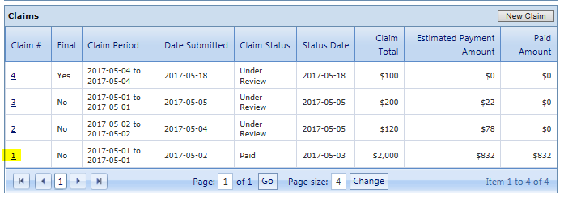
Users have the ability to generate a printable report showing claim details. There are two options, Unadjusted (details as submitted) or Adjusted (including any changes made by Ministry staff, post-submission).
On the main project screen, select a claim by clicking the claim number (hyperlink).

Slide 5
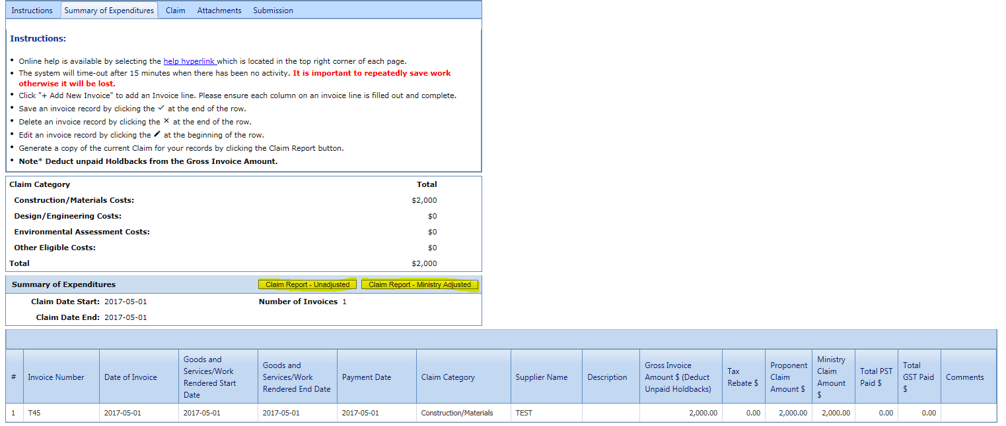
Click on the Summary of Expenditures tab.
Select either ‘Claim Report – Unadjusted’ or ‘Claim Report - Ministry Adjusted’
NOTE: ‘Claim Report - Ministry Adjusted’ available post-submission only.

Slide 6
LGIS Website :
https://www.localgovernmentinformationsystem.gov.bc.ca/
For access and technical assistance please contact: Phone: (250) 953-3008 Email : LGIS.AccessRequest@gov.bc.ca
For program and claim assistance please contact: Phone: (250) 387-4060 Email : infra@gov.bc.ca

