Slide 1
Infrastructure Planning Grant
Application Process
View an Application

Slide 2
View an Infrastructure Planning Grant Application
This guide will walk you through how to view an Infrastructure Planning Grant Application in LGIS. Users may view their organization’s applications at any time.
*Note: LGIS is best viewed using Internet Explorer 11 with add-ons disabled.

Slide 3
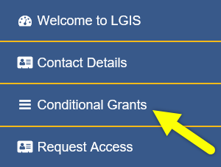
Start by clicking Conditional Grants

Slide 4
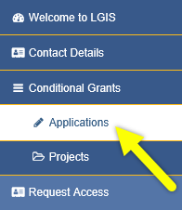
Then click Applications

Slide 5
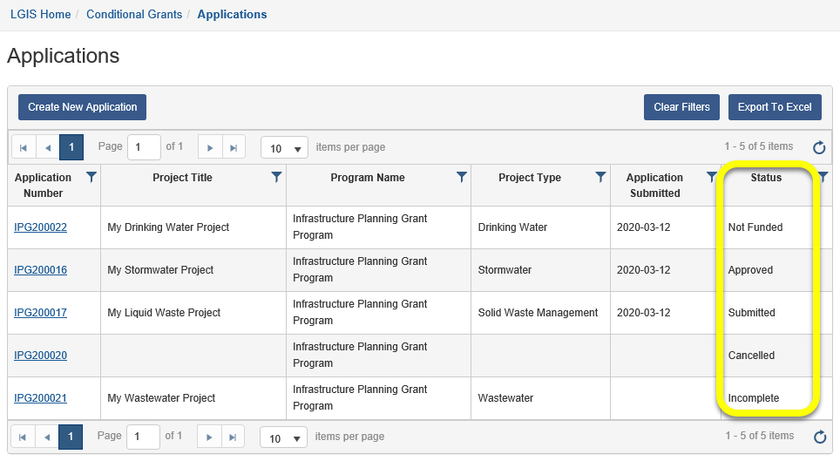
The screenshot below shows the Applications screen. If you have infrastructure grant applications, they will show here.
Applications in an Incomplete status can be re-opened to continue editing.
Applications in a(n) Approved, Submitted, Not Funded or Cancelled status are read-only.
The Status column will update as submitted applications are reviewed by Ministry staff.

Slide 6
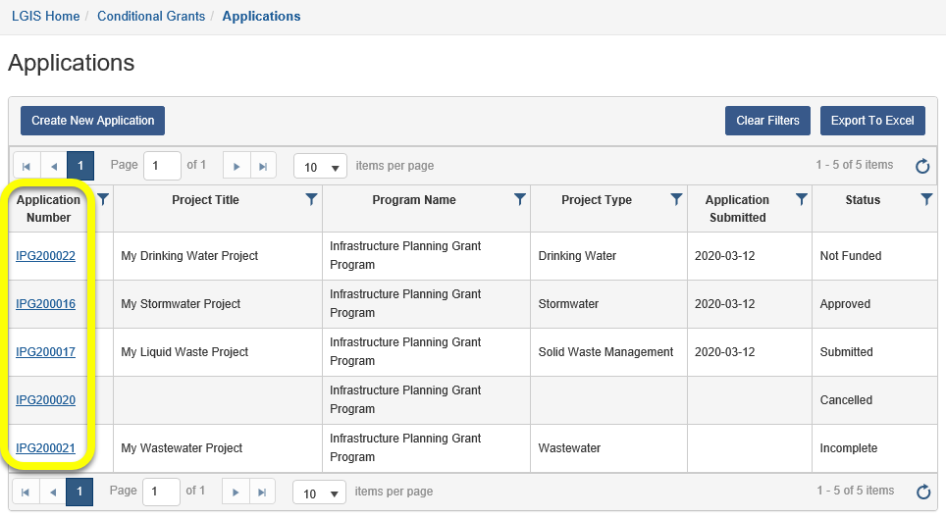
To view an application, click the Application Number link.

Slide 7
LGIS Website : https://www.localgovernmentinformationsystem.gov.bc.ca/EXT/default.aspx
For access and technical assistance please contact: Phone: (250) 953-3008* Email : LGIS.AccessRequest@gov.bc.ca*
For program and claim assistance please contact: Phone: (250) 387-4060* Email : infra@gov.bc.ca*
*Please allow response time of up to 2 business days.
Notes:
Confirm all info before publishing. Note: response time can be 1-2 business days?

