Slide 1
Infrastructure Planning Grant
Claim Process
View a Claim

Slide 2
View an Infrastructure Planning Grant Claim
This guide will teach you how to view existing claims associated with your Infrastructure Planning Grant Project.
*Note: LGIS is best viewed using Internet Explorer 11 with add-ons disabled.

Slide 3
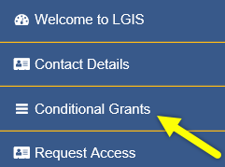
Start by clicking Conditional Grants

Slide 4
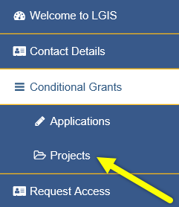
Then click Projects

Slide 5
Click on the Project Number of the project with a claim(s) you want to view

Slide 6
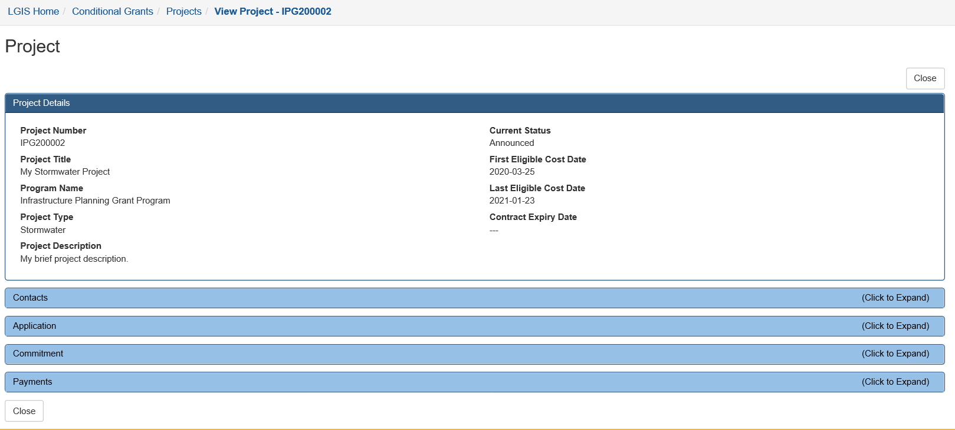
When you click on the Project Number link the Project page opens.
Now, with the Project page open, click to expand the Payments (Claims) section.

Slide 7
You can view your organization’s claims at any time via this Payments section.
Claims in an ‘Incomplete’ status can be re-opened to continue editing.
Claims in a(n) ‘Under Review’, ‘Cancelled’ or ‘Paid’ status are read-only (editing is disabled).
The Status column will update as submitted claims are reviewed by Ministry staff.
Notes:
Click on number to open claim. Add screenshot?

Slide 8
Click on any claim number link to view the corresponding claim.

Slide 9
LGIS Website : https://www.localgovernmentinformationsystem.gov.bc.ca/EXT/default.aspx
For access and technical assistance please contact: Phone: (250) 953-3008* Email : LGIS.AccessRequest@gov.bc.ca*
For program and claim assistance please contact: Phone: (250) 387-4060* Email : infra@gov.bc.ca*
*Please allow response time of up to 2 business days.
Notes:
Confirm all info before publishing. Note: response time can be 1-2 business days?

