Slide 1
Infrastructure Planning Grant
Claim Process
Submit a Claim

Slide 2
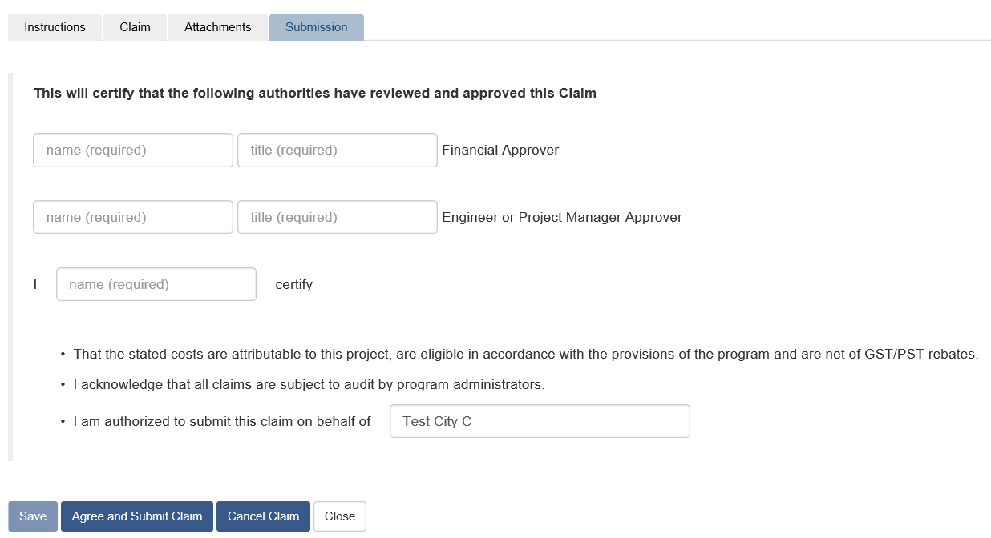
Submit an Infrastructure Planning Grant Claim
This guide will teach you how to submit an Infrastructure Planning Grant Claim. You will need to have created a claim and completed the claim form in its entirety before being able to submit a claim.
*Note: LGIS is best viewed using Internet Explorer 11 with add-ons disabled.

Slide 3
With your claim form open; click on the Submission tab. Complete all required fields.

Slide 4
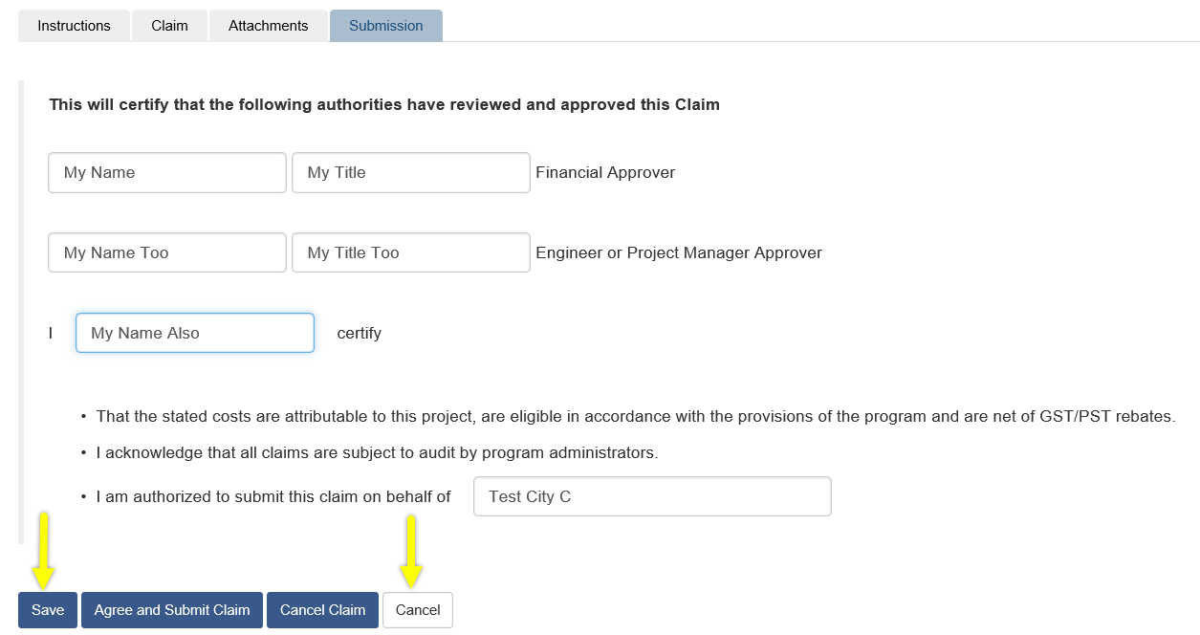
After filling out the required fields you will notice the Save button is now enabled. Also, the Close button now says Cancel

Slide 5
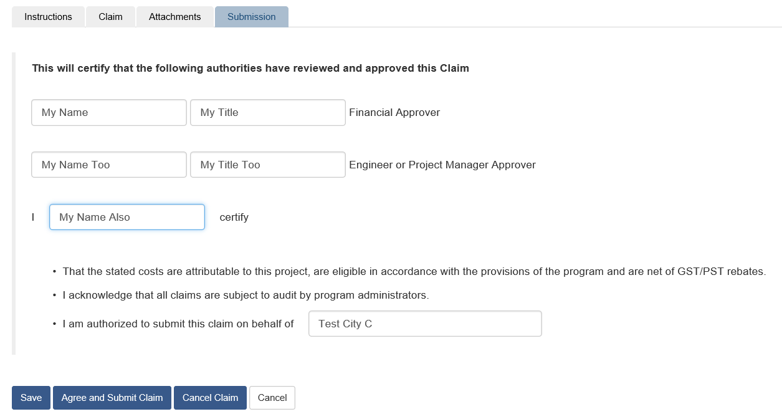
You now have four options:
Cancel your last unsaved changes and return to the Projects screen.
Cancel the entire claim.
Save then Close the claim, allowing you to return and edit the claim at a later time.
Agree and Submit the claim, submitting the claim to the Ministry.
*Note: Once your claim is submitted, the form can no longer be edited. If edits are required, please contact the Ministry.

Slide 6
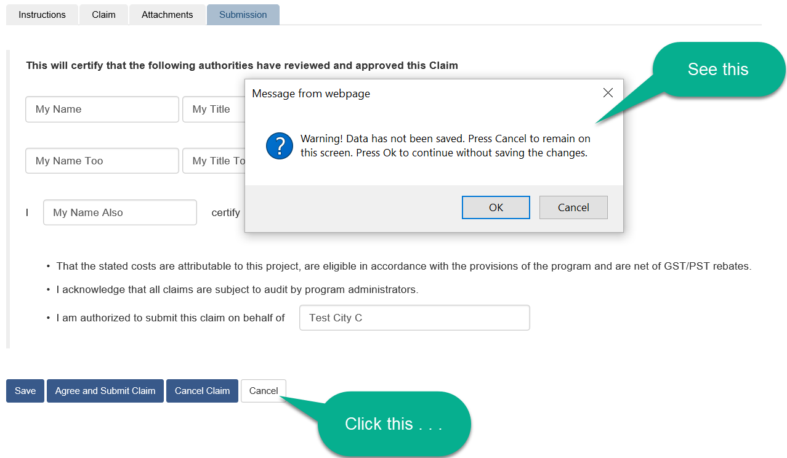
Cancel unsaved changes and return to the Projects screen
When you click the Cancel button you see a warning message. Click Cancel in the pop-up to remain on the Submission tab. Click OK in the pop-up to return to the Project screen.

Slide 7
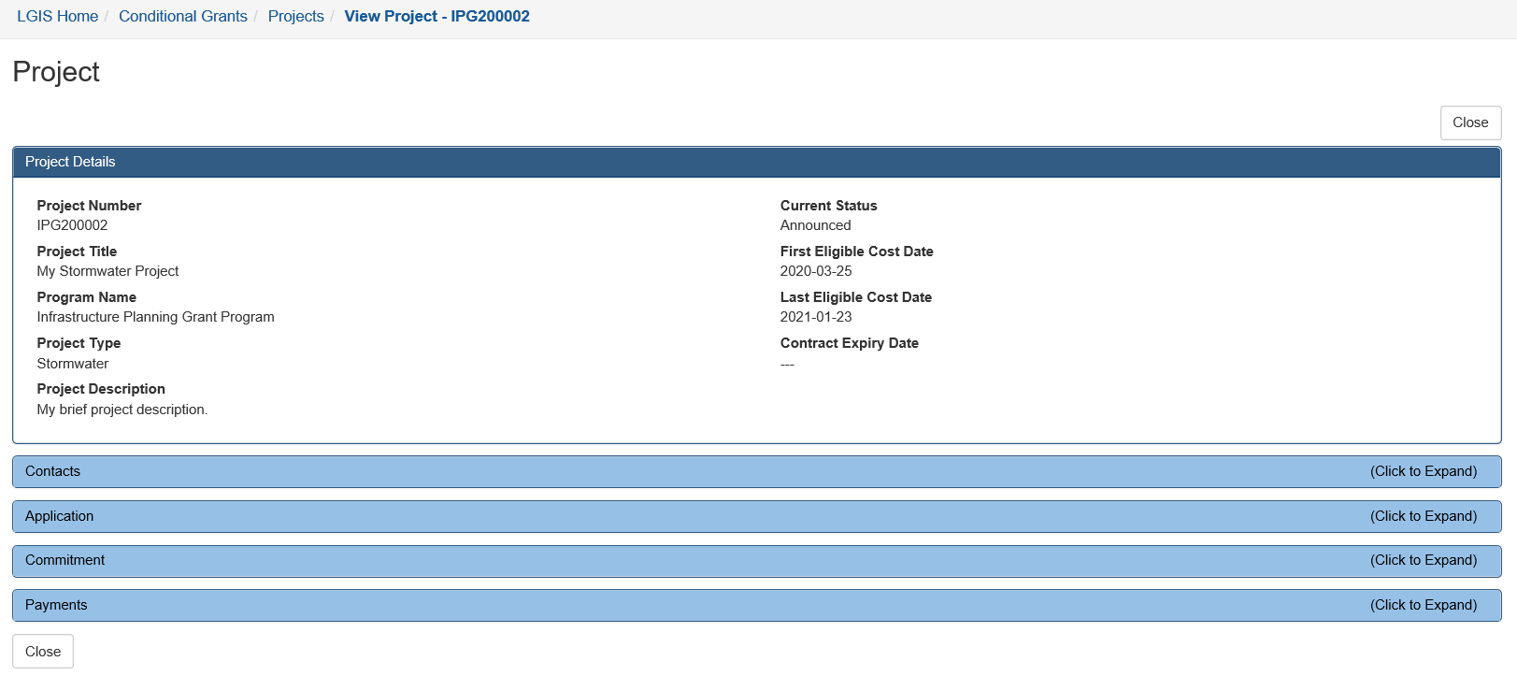
If you click OK in the warning pop-up you will be returned to the Project screen.

Slide 8
Click to expand the Payments dropdown. Notice the claim you created is in Incomplete status.

Slide 9
Cancel the claim.
This option will cancel the entire claim. You will not be able to return to the claim, make edits or submit.

Slide 10
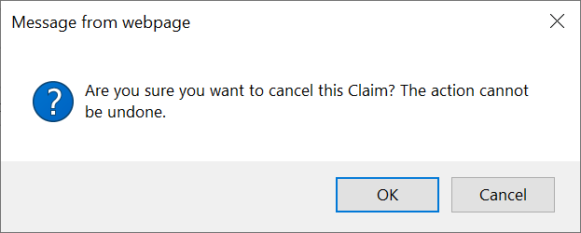
Cancel the claim continued . . .
You will see a pop-up message. Click OK to cancel the claim and return to the Instructions tab. Click Cancel to return to the Submission tab.

Slide 11
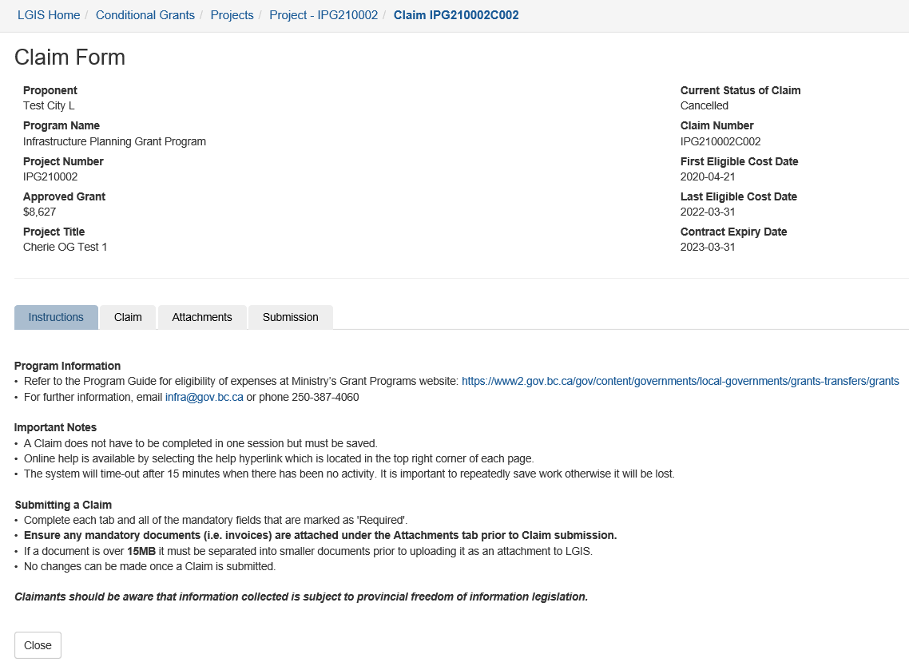
Cancel the claim continued . . .
If you choose to click OK in the pop-up you will return to the Instructions tab.

Slide 12
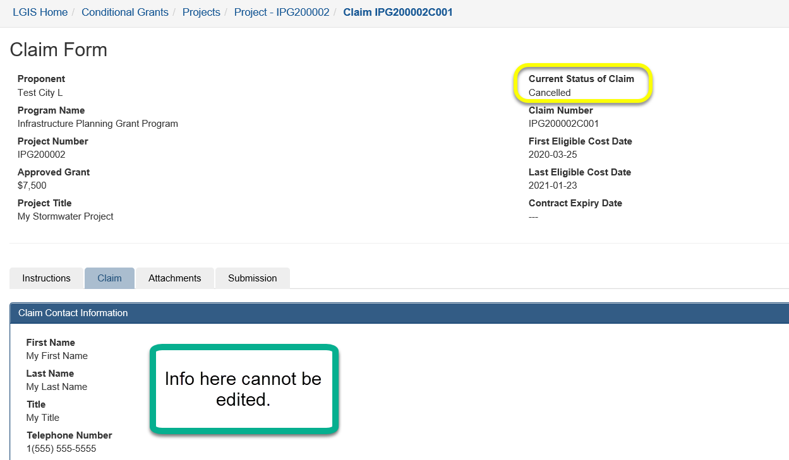
Cancel the claim continued . . .
Notice the Current Status of Claim is Cancelled and if you click on another tab the information cannot be edited

Slide 13
Save then close
This option allows you to save all your changes and return to complete the claim at a later date.

Slide 14
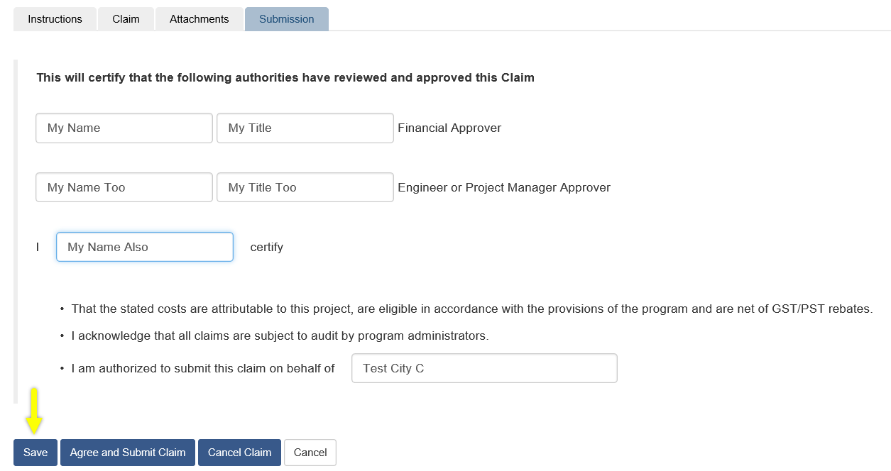
Save then close continued . . .
Click Save

Slide 15
Save then close continued . . .
After clicking Save you should see this success message.

Slide 16
Save then close continued . . .
Click Close.

Slide 17
When you click Close you will be returned to the Project screen.

Slide 18
Click to expand the Payments dropdown. Notice the claim you created is in Incomplete status.

Slide 19
Agree and submit claim
This option allows you to agree to the statement on the Submission tab and submit your claim to the Ministry

Slide 20
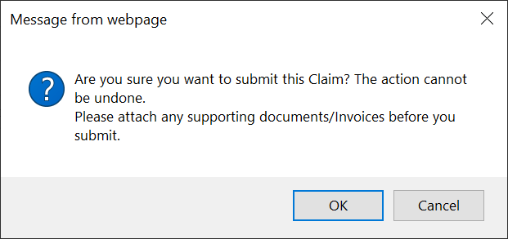
Agree and submit claim continued . . .
Click Save, then click Agree and Submit Claim
Once you click Agree and Submit Claim you will see this message

Slide 21
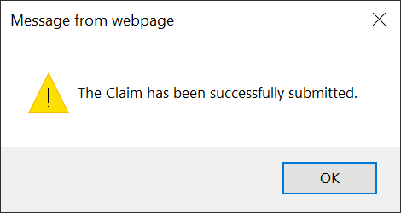
Agree and submit claim continued . . .
Click OK in the message box and you will see this success message.

Slide 22
Agree and submit claim continued . . .
Click OK in the message box and you will be returned to the Instructions tab.

Slide 23
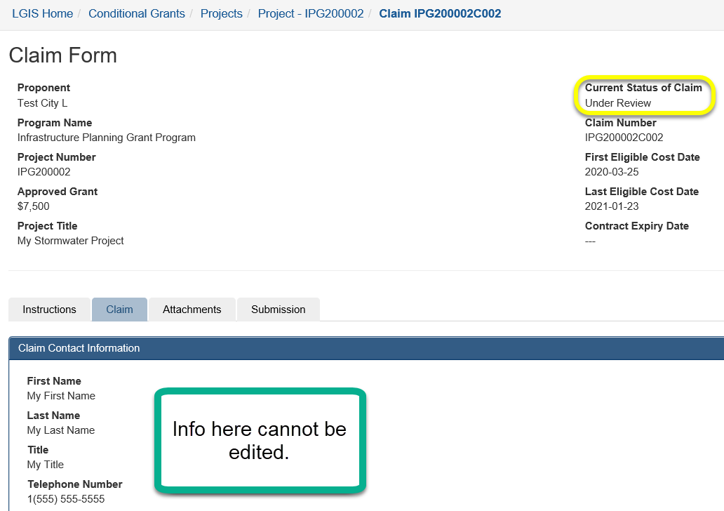
Agree and submit claim continued . . .
Notice the Current Status of Claim is Under Review and if you click on another tab the information cannot be edited

Slide 24
LGIS Website : https://www.localgovernmentinformationsystem.gov.bc.ca/EXT/default.aspx
For access and technical assistance please contact: Phone: (250) 953-3008* Email : LGIS.AccessRequest@gov.bc.ca*
For program and claim assistance please contact: Phone: (250) 387-4060* Email : infra@gov.bc.ca*
*Please allow response time of up to 2 business days.
Notes:
Confirm all info before publishing. Note: response time can be 1-2 business days?

