Slide 1

Infrastructure Planning Grant
Claim Process
Create a Claim
Notes:
Remove ministry name. center all graphics

Slide 2
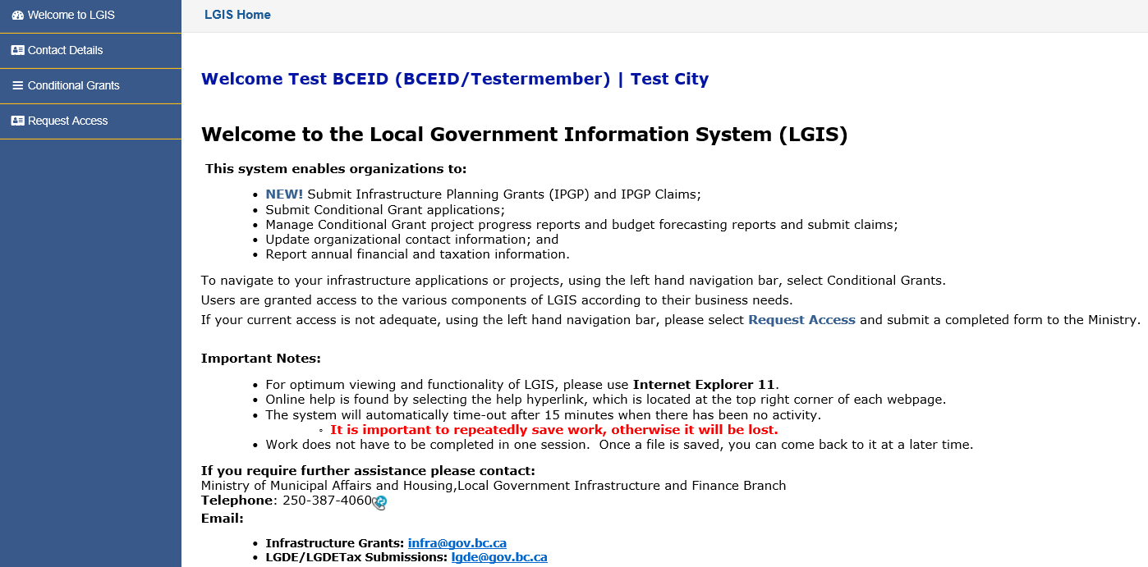
Create an Infrastructure Planning Grant Claim
This guide will teach you how to create an Infrastructure Planning Grant Claim. Claims do not have to be completed or submitted in one session. However, users must complete the claim form in its entirety before being able to submit a claim.
*Note: LGIS is best viewed using Internet Explorer 11 with add-ons disabled.

Slide 3
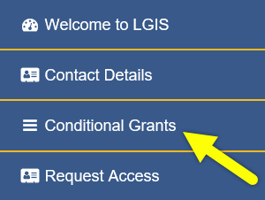
Start by clicking Conditional Grants

Slide 4
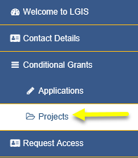
Then click Projects.

Slide 5
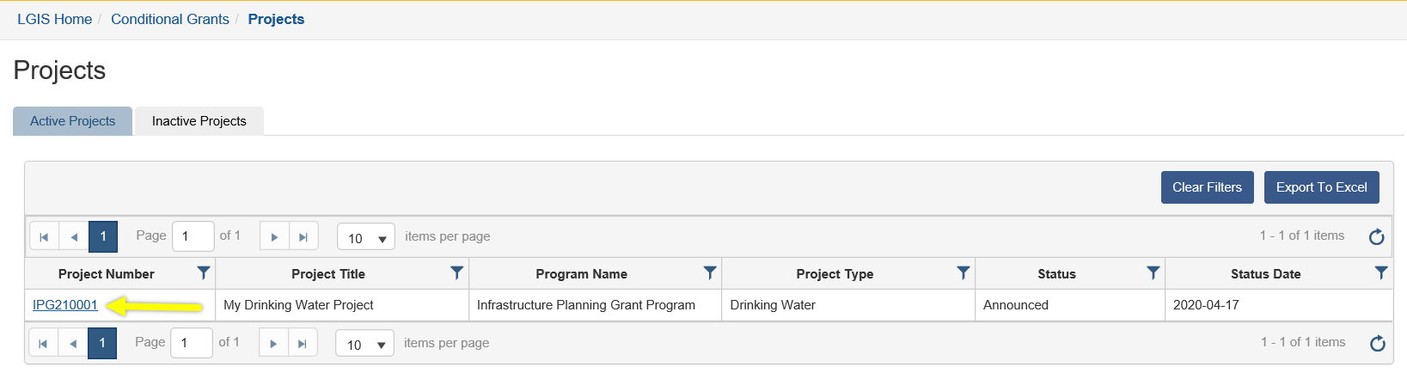
Click on the Project Number link. The Project screen will open.*
*Note: Claims can only be created for Active Projects.
Notes:
Any info needed for inactive projects?

Slide 6
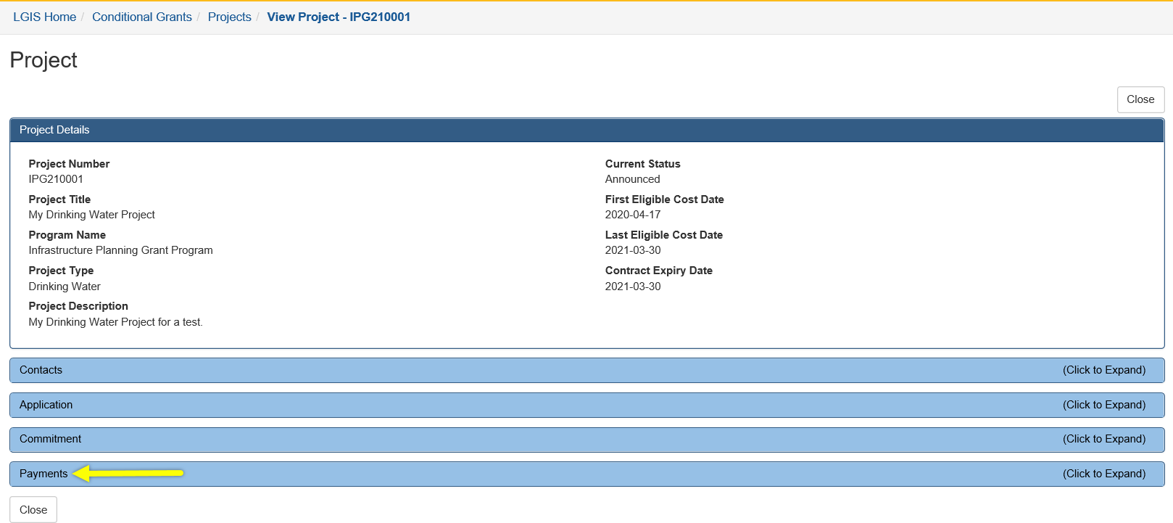
Click on Payments.*
*Note: The Payments section lists all payments, (Claims and Disbursements) if any, that exist for the project.

Slide 7
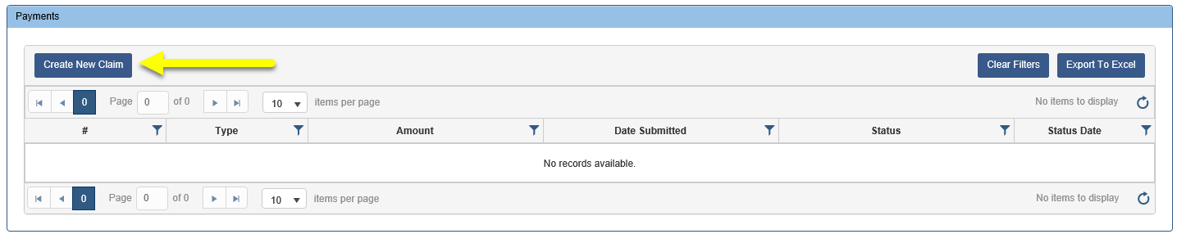
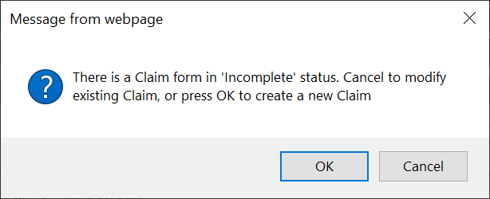
Click Create New Claim.*
If you have an existing claim in Incomplete status, you will see the following message:
*Note: A new claim cannot be created without a ‘Confirmed Active’ Contract Agreement in effect.

Slide 8
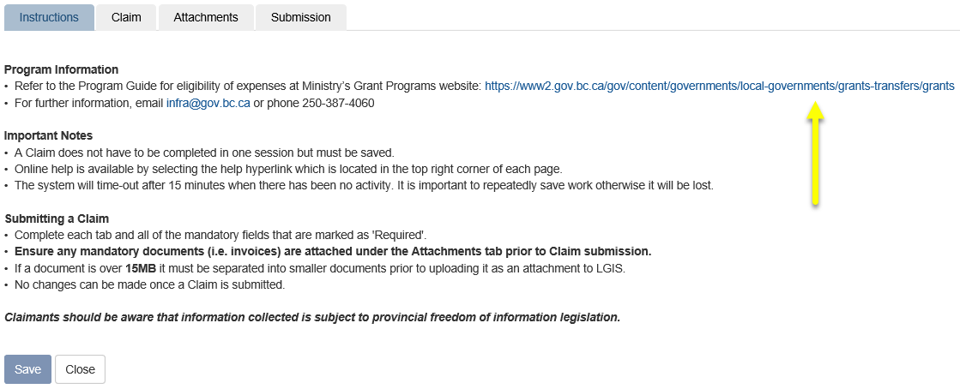
Review the Instructions tab prior to proceeding in the Claim form.*
https://www2.gov.bc.ca/gov/content/governments/local-governments/grants-transfers/grants/
*Note: Proponents are encouraged to review the Program Guide prior to submitting a claim.

Slide 9
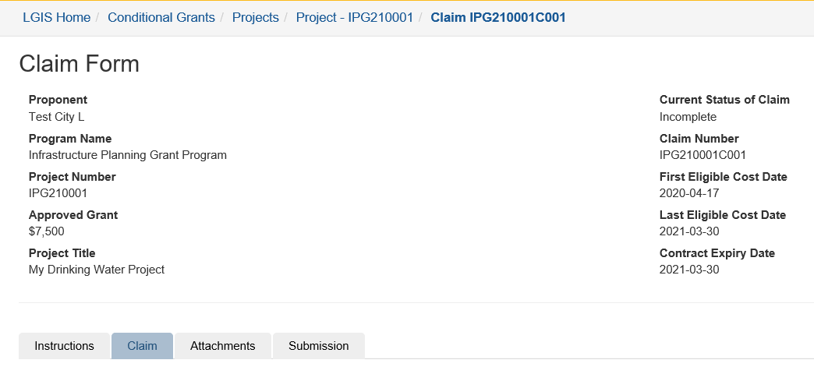
Click on the Claim tab.

Slide 10
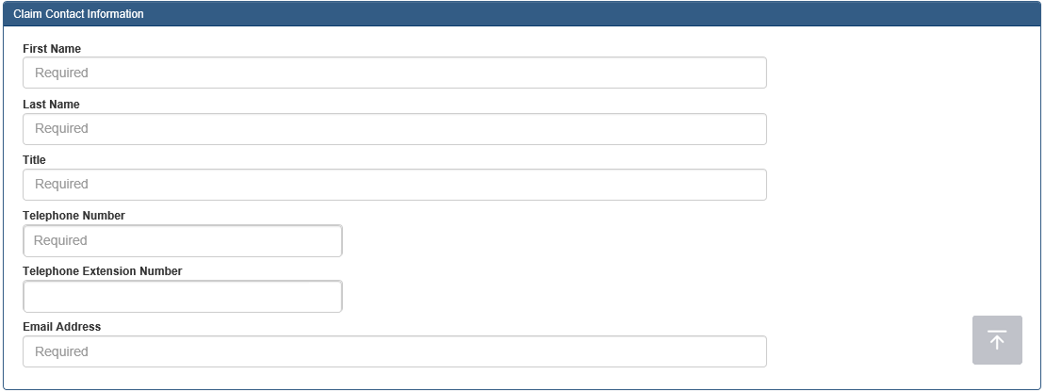
Complete required fields and click Save..

Slide 11
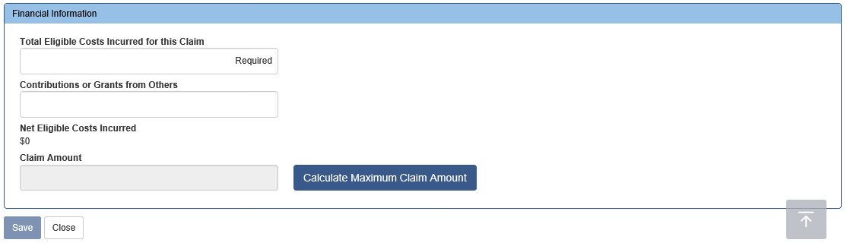
Claim tab required fields continued . . .*
*Note: Claim Amount can be calculated either by clicking Save or Calculate Maximum Claim Amount
Notes:
Arrows etc. needed in screenshot?

Slide 12
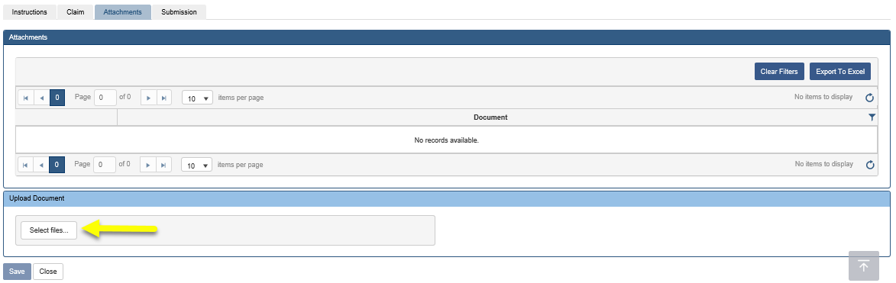
Click on the Attachments tab. Click on Select files . . . Upload all mandatory and supplementary documents (see Program Guide for further information on mandatory documents and file types).
*Note: All invoices applicable to the claim must be uploaded. Each document cannot exceed 15MB. Zip and .exe files will not be reviewed. Documents cannot be uploaded or deleted once the claim is submitted.

Slide 13
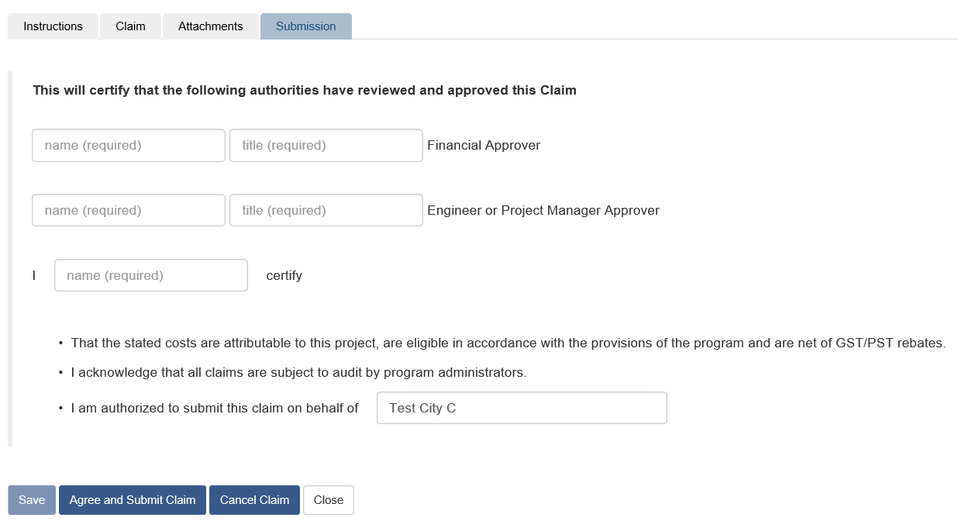
After uploading documents and clicking save you can close the form and return later to submit your claim, or proceed to the Submission tab displayed below.
Please see the Submitting an Infrastructure Planning Grant claim PowerPoint on the LGIS Training site for instructions on how to submit your claim.

Slide 14
LGIS Website :
https://www.localgovernmentinformationsystem.gov.bc.ca/EXT/default.aspx
For access and technical assistance please contact:
Phone: (250) 953-3008*
Email : LGIS.AccessRequest@gov.bc.ca*
For program and claim assistance please contact:
Phone: (250) 387-4060*
Email : infra@gov.bc.ca*
*Please allow response time of up to 2 business days.
Notes:
Confirm all info before publishing. Note: response time can be 1-2 business days?

