Slide 1
Infrastructure Planning Grant
Application Process
Complete an Application

Slide 2
Completing an Infrastructure Planning Grant Application
This guide will teach you how to complete an Infrastructure Planning Grant Application. You will need to have created an application in order to follow this guide. When you create an application, the application form shows.
Information relevant to the application, including Program Name and Application Number, is shown in the application form.*
*Note: Users cannot submit the form until it is completed in its entirety. An application does not have to be submitted in one session, but must be saved.
*Note: LGIS is best viewed using Internet Explorer 11 with add-ons disabled.

Slide 3
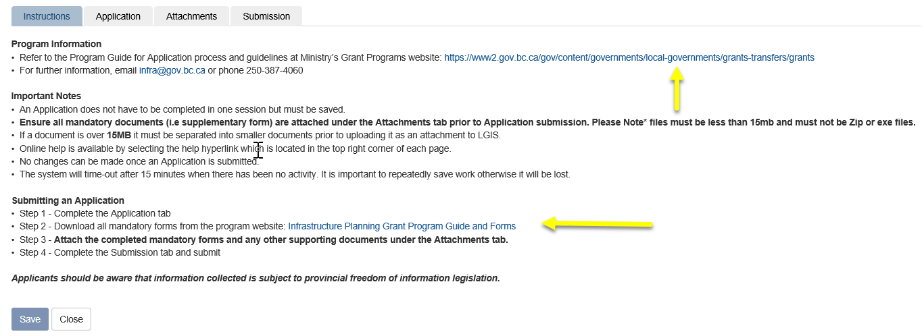
Review the Instructions tab prior to proceeding in the application form. Click on the hyperlinks to find the Program Guide and program-specific forms. The Program Guide provides information on eligibility and the application process.*
https://www2.gov.bc.ca/gov/content/governments/local-governments/grants-transfers/grants
Infrastructure Planning Grant Program Guide and Forms
*Note: Proponents are encouraged to consult the Program Guide before completing the application.
Notes:
Need to redo screenshot once instructions/links updated for new intake

Slide 4
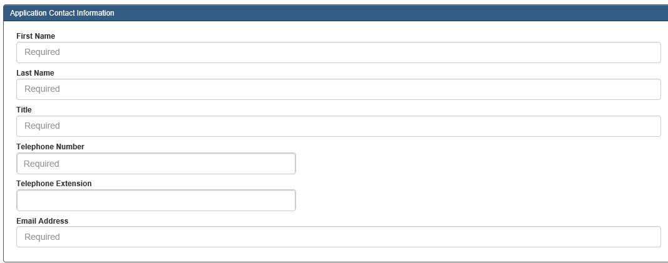
Click on the Application tab after you have reviewed the Instructions tab. Complete required fields and click Save.

Slide 5
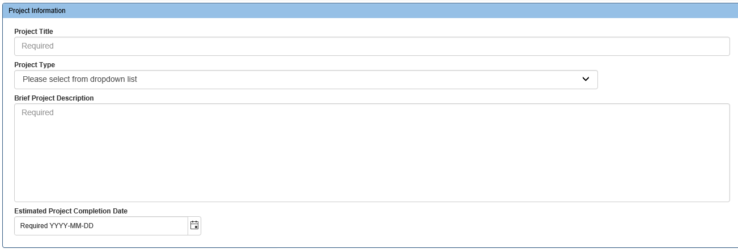
Application tab required fields continued . . .

Slide 6
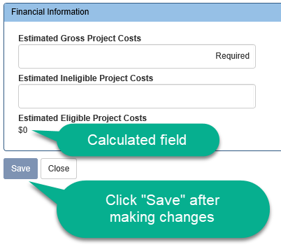
Application tab required fields continued . . .
*Note: Estimated Eligible Project Costs amount is calculated by the system. Estimated Gross Project Costs less Estimated Ineligible Project Costs = Estimated Eligible Project Costs, this amount cannot be a negative number.

Slide 7
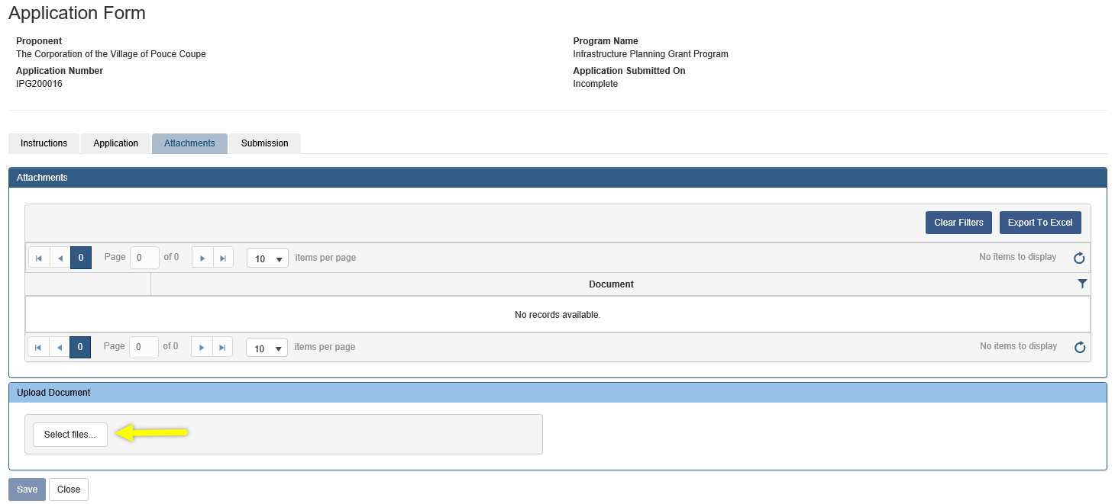
Click on the Attachments tab. Click on Select files . . . and upload all mandatory and supporting documentation.* Documents must be less than 15MB in size. Zip files and .exe files will not be accepted. Once you have submitted your application form you will no longer be able to delete or upload attachments.
*Note: Proponents are encouraged to consult the Program Guide for information on mandatory and suggested supporting documentation as well as requested file formats.

Slide 8
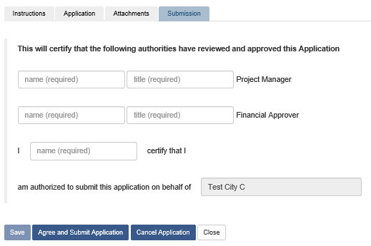
Click on the “Submission” tab and you will see the screen displayed below. You can close the form and return later to submit your application, or proceed with submitting your application.
Please see the Submitting an Infrastructure Planning Grant Application PowerPoint on the LGIS Training site for instructions on how to submit your application.

Slide 9
LGIS Website : https://www.localgovernmentinformationsystem.gov.bc.ca/EXT/default.aspx
For access and technical assistance please contact: Phone: (250) 953-3008* Email : LGIS.AccessRequest@gov.bc.ca*
For program and claim assistance please contact: Phone: (250) 387-4060* Email : infra@gov.bc.ca*
*Please allow response time of up to 2 business days.

